Slide 1





SQL Project
SQL Queries and Analysis:
Imdb Top 1000 Movie Database Project

Slide 2
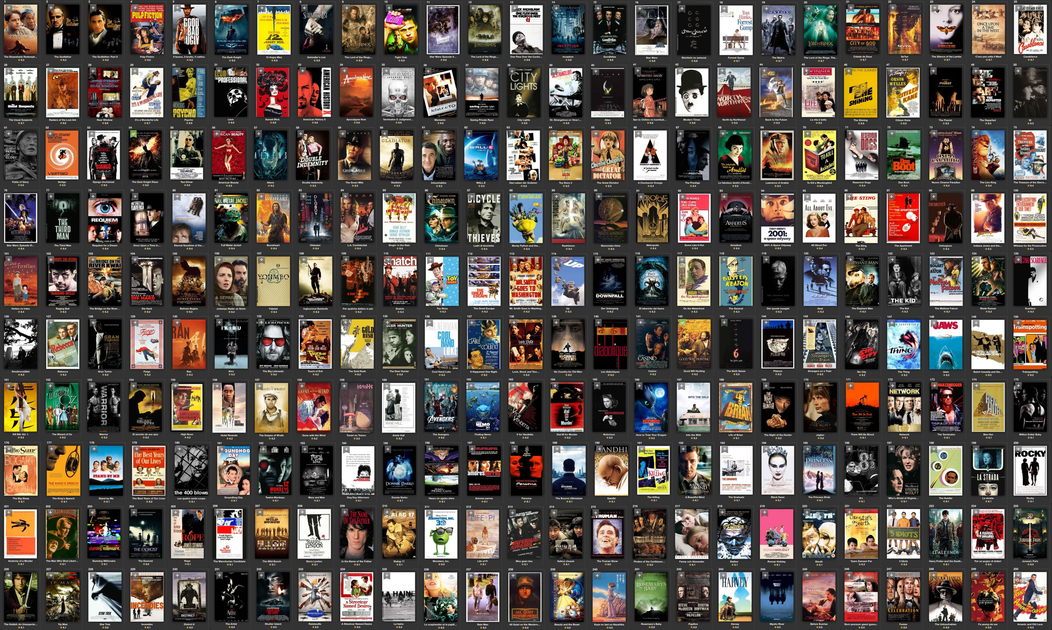

OVERVIEW
Introduction to the Project
Data Exploration
Data Cleaning & Transformation
Aggregate Analysis
Top Grossing & Highest Rated Movies
Director and Actor Insights
Genre-Based Analysis
Year-Based Analysis
Time-Based Trends
Conclusion

Slide 3

INTRODUCTION
This project analyzes the Imdb Top 1000 movies dataset using SQL to explore trends in ratings, box office performance, and the influence of directors and actors. The goal is to identify top-performing movies, explore patterns over time, and understand how various factors like genre, rating, and cast impact movie success.

Slide 4

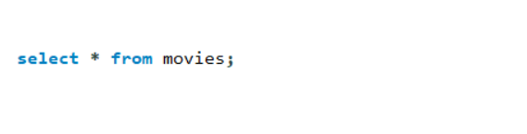
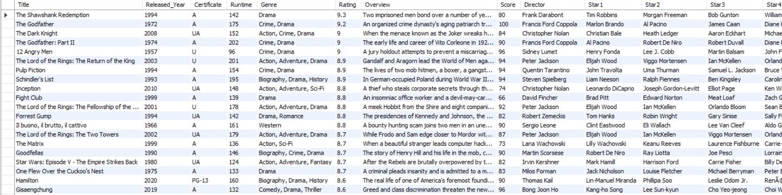
Data Exploration

Slide 5
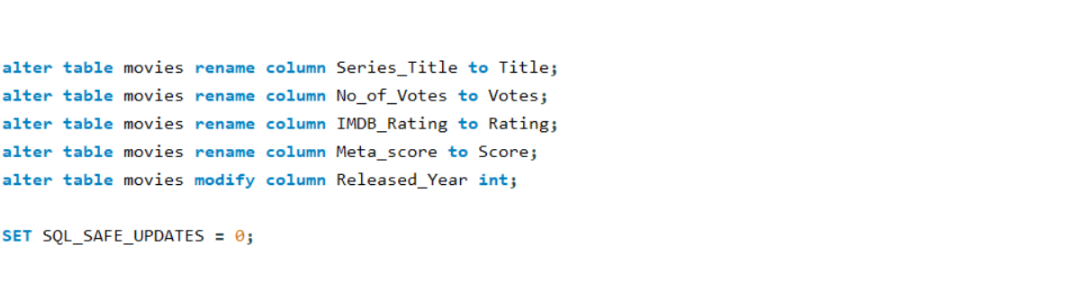
Data Cleaning & Transformation
Renaming Columns

Slide 6
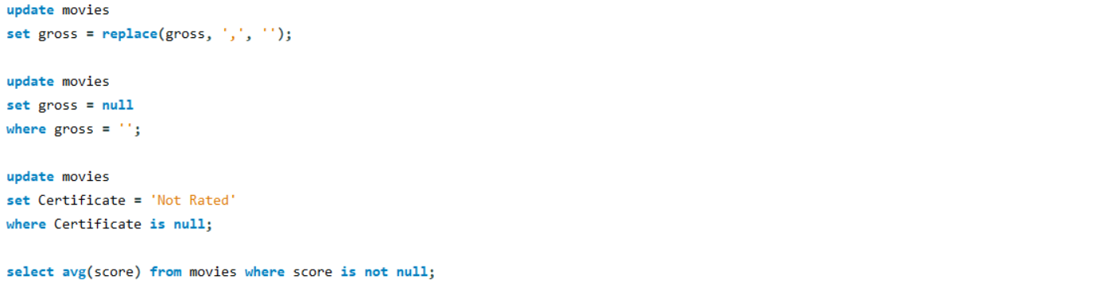
Data Cleaning & Transformation
Cleaning Data

Slide 7
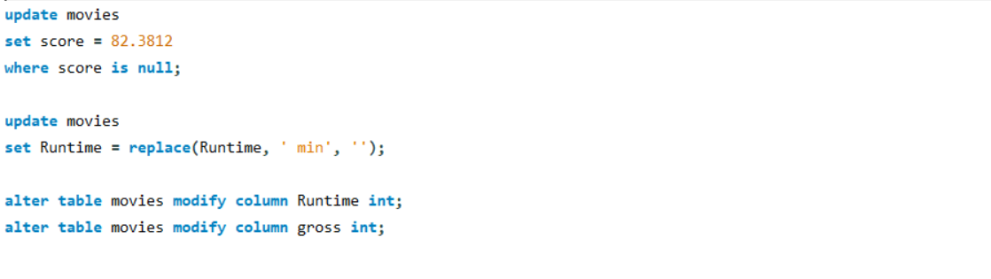
Data Cleaning & Transformation
Cleaning Data

Slide 8
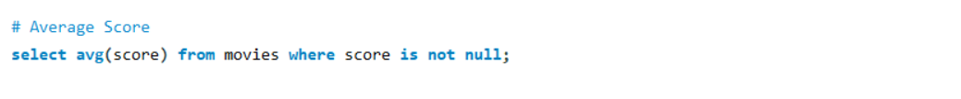
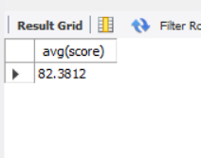
Aggregate Analysis

Slide 9
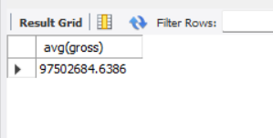
Aggregate Analysis

Slide 10
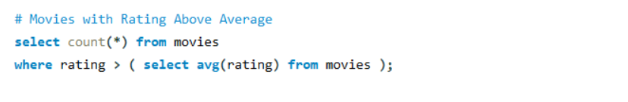
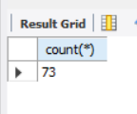
Aggregate Analysis

Slide 11
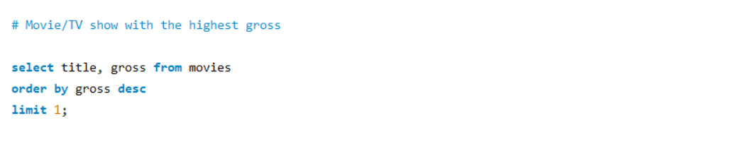
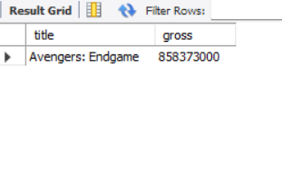
Top Grossing & Highest Rated Movies

Slide 12
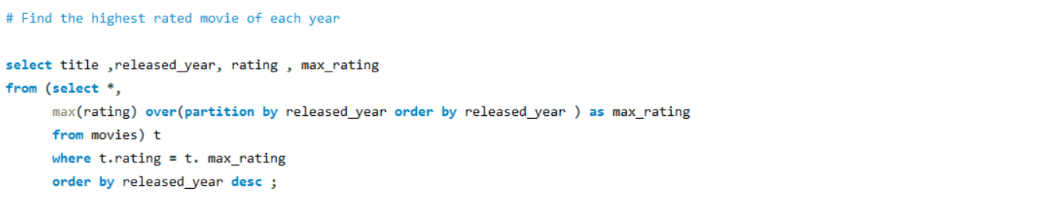
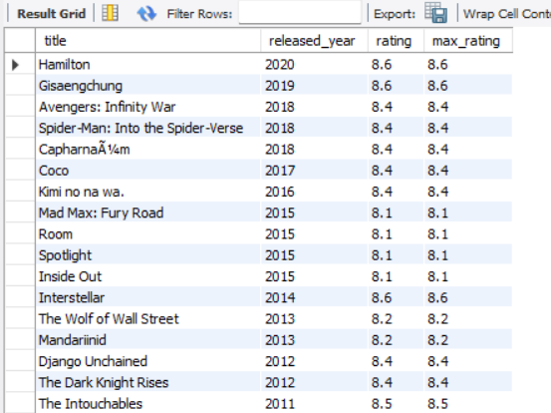
Top Grossing & Highest Rated Movies

Slide 13
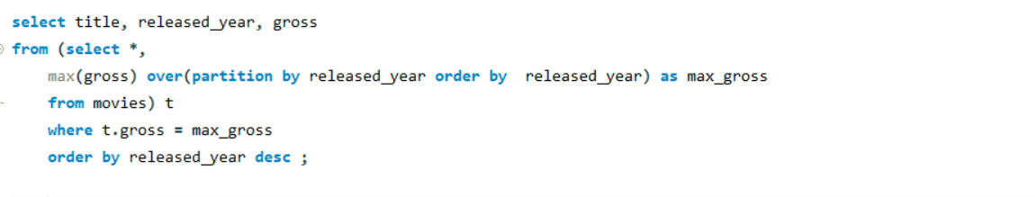
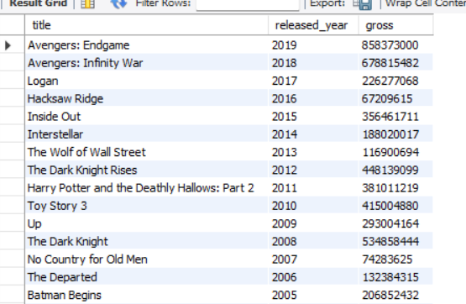
Top Grossing & Highest Rated Movies

Slide 14
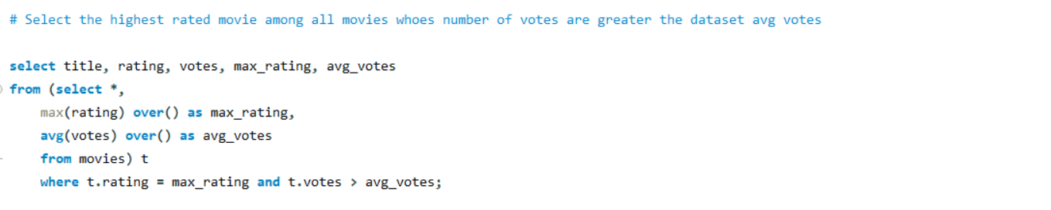
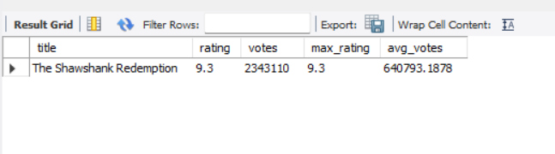
Top Grossing & Highest Rated Movies

Slide 15
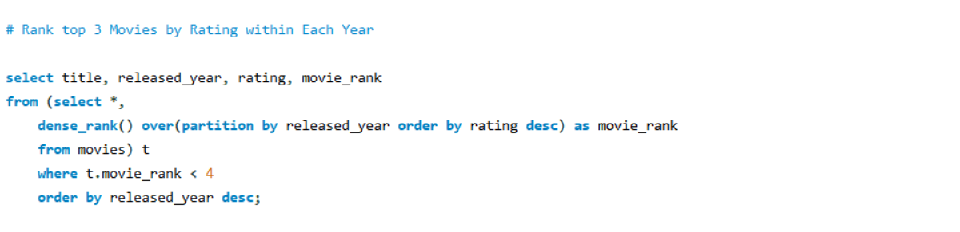
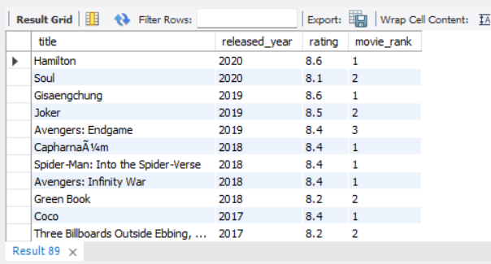
Top Grossing & Highest Rated Movies

Slide 16
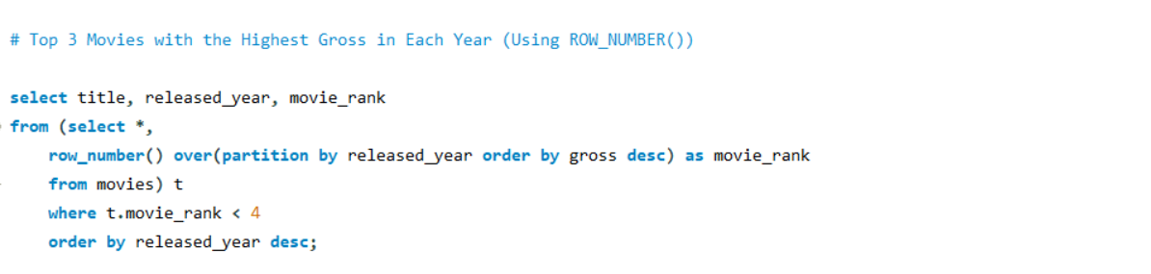
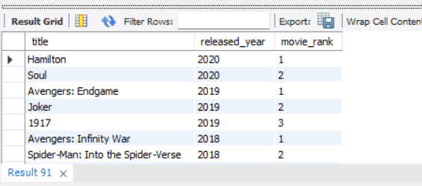
Top Grossing & Highest Rated Movies

Slide 17
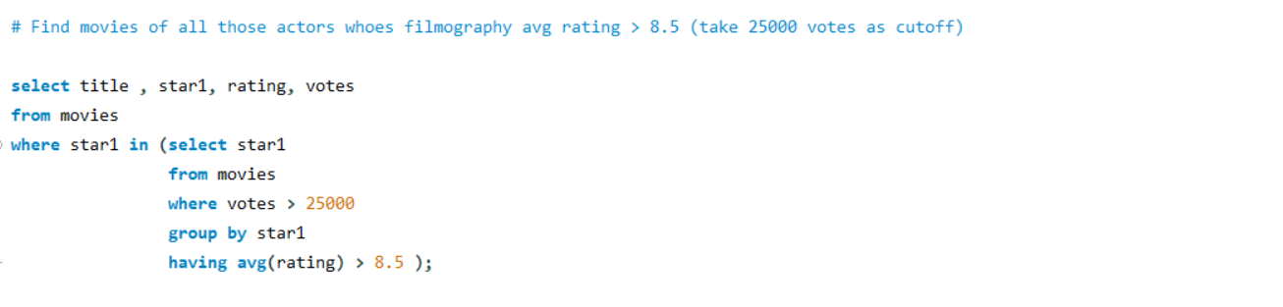
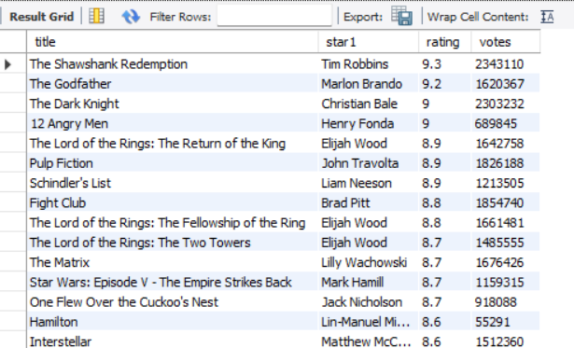
Director and Actor Insights

Slide 18
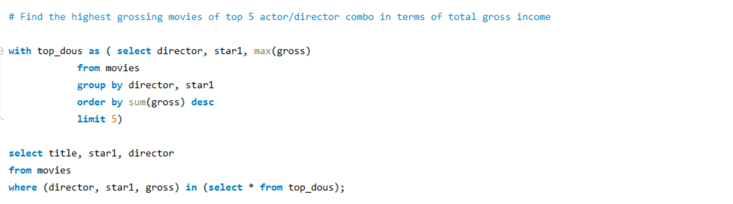
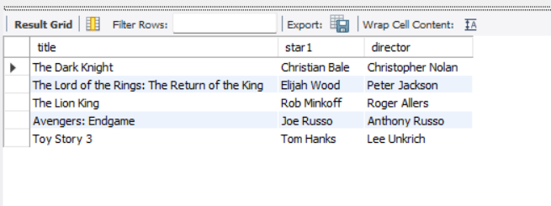
Director and Actor Insights

Slide 19
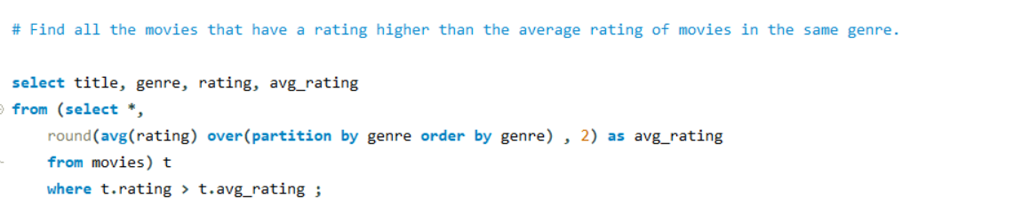
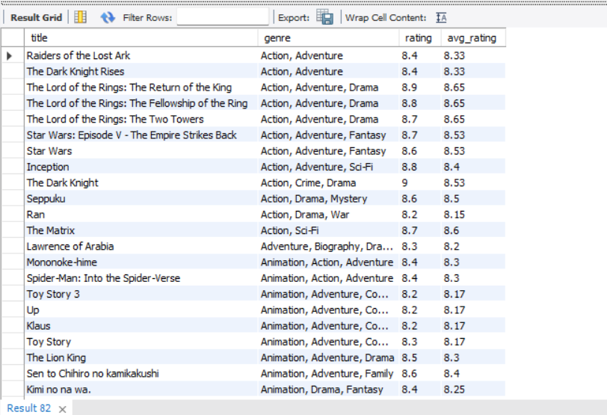
Genre - Based Analysis

Slide 20
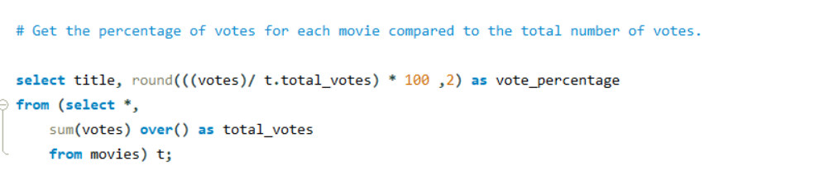
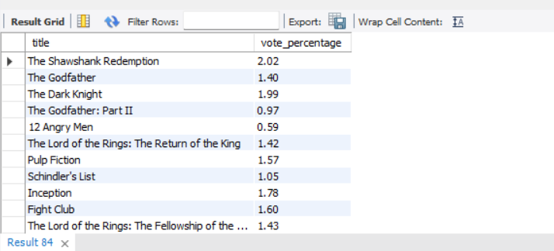
Genre - Based Analysis

Slide 21
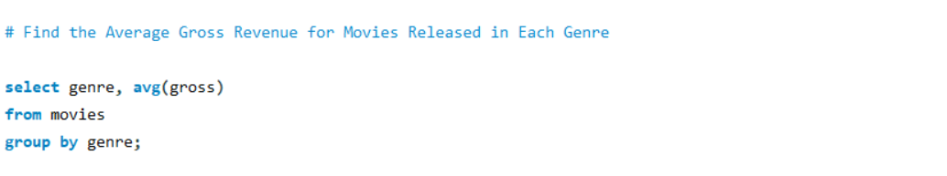
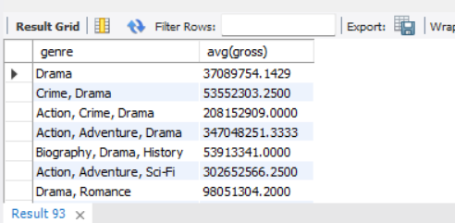
Genre - Based Analysis

Slide 22
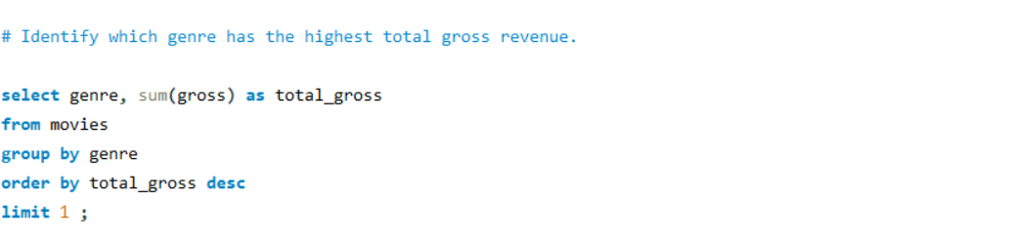
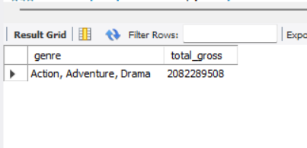
Genre - Based Analysis

Slide 23
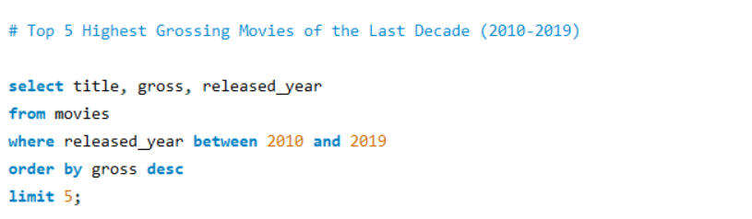
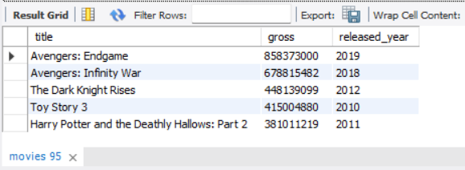
Year - Based Analysis

Slide 24
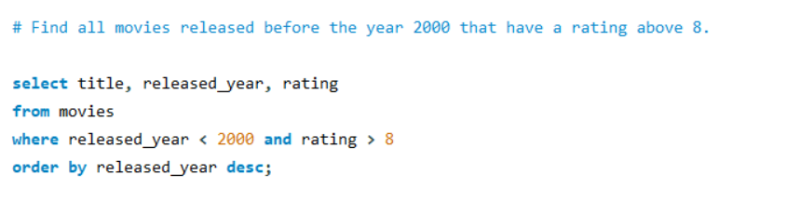
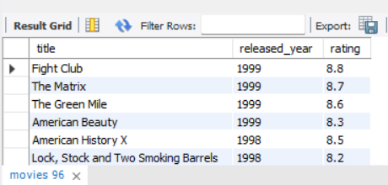
Year - Based Analysis

Slide 25
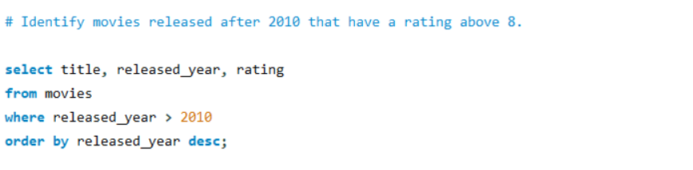
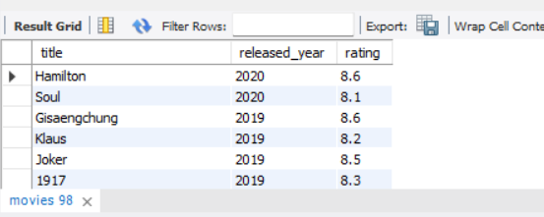
Year - Based Analysis

Slide 26
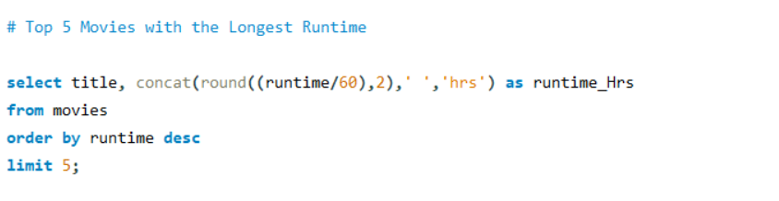
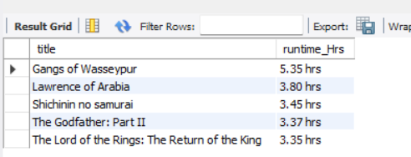
Time - Based Analysis

Slide 27
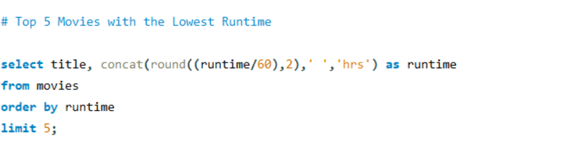
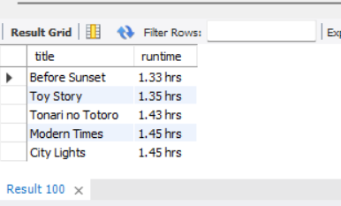
Time - Based Analysis

Slide 28
Summary of Analysis:
This project analyzed the Imdb Top 1000 movies dataset to explore various factors influencing a movie's success. The SQL queries provided insights into aspects such as gross revenue, ratings, votes, and genre trends.

Slide 29
Key Insights
Highest Grossing Movies: The queries identified the highest-grossing movies and compared them by year.
Top-rated Movies: The highest-rated movies were explored, including those exceeding average ratings for specific genres and years.
Director & Actor Impact: Insights into the top directors and actors were derived by analyzing their combined contributions to movie success.
Genre Trends: A genre-based analysis highlighted the most profitable and highly-rated genres.
Time-based Trends: The analysis revealed patterns in movie performance over the years, including highest-grossing and highest-rated films per year.

Slide 30
Conclusion
By evaluating these factors, the project reveals that successful movies are often those with a high number of votes, strong ratings, and significant gross revenue. Additionally, directors and actors play a crucial role in determining a movie's success, as seen in the analysis of top directors and actors. Furthermore, genre and certificate type also influence average ratings and revenues. The trends over time indicate that certain genres and specific time periods are more successful than others.

Slide 31
Project Summary & Insights
This analysis provides valuable insights for filmmakers, production houses, and investors to make informed decisions about future movie productions based on historical data trends.

Slide 32


THANK TOU
For watching this presentation

